Slide 1
Course-Advisor
YOUR GPT-based Course Selection Assistant

Slide 2
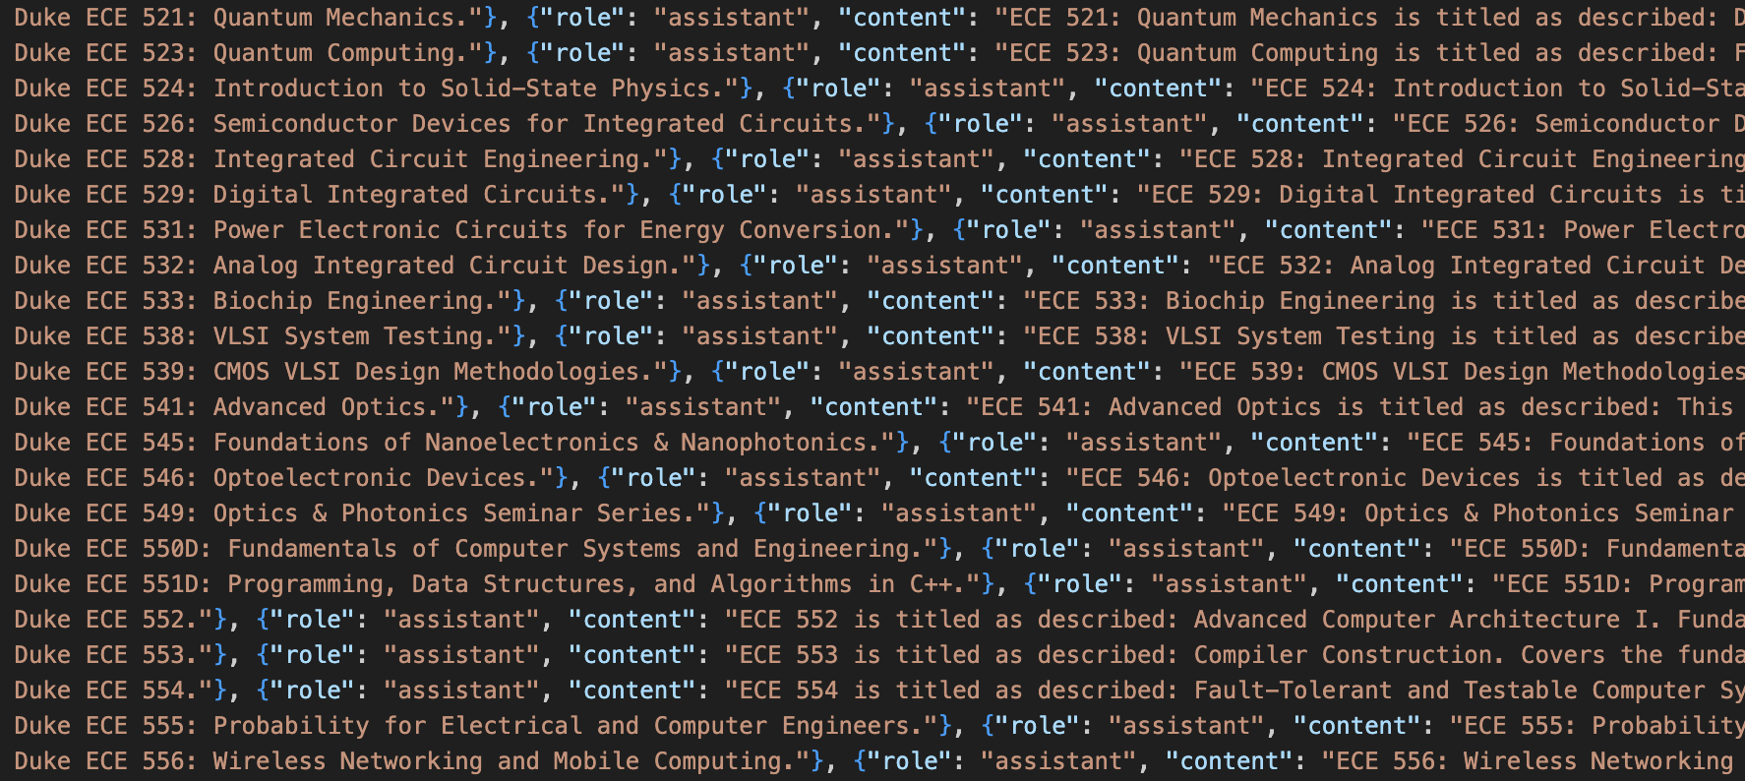
Collect Data from Website
Use script to extract data from documents or course websites
Clean and format the data

Slide 3
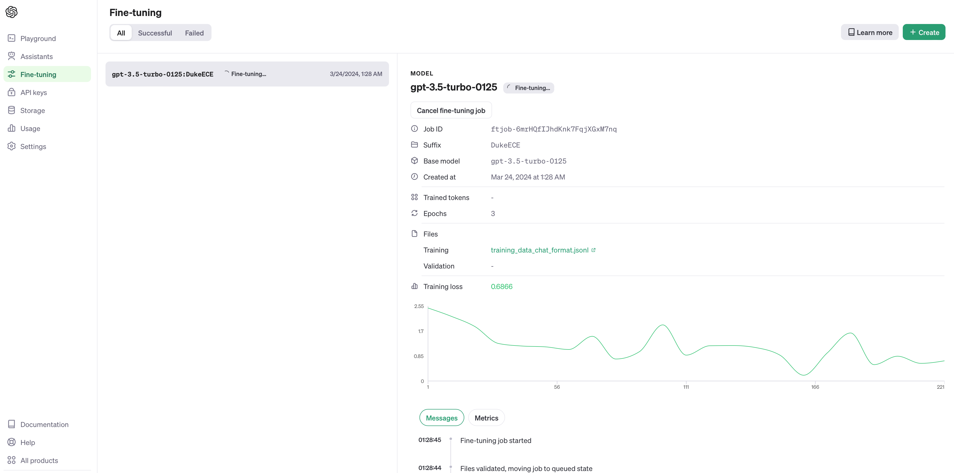
Fine tuning
Fine-tuning allows me to leverage the knowledge already encoded in the pre-trained model while tailoring it to better suit your specific needs.

Slide 4
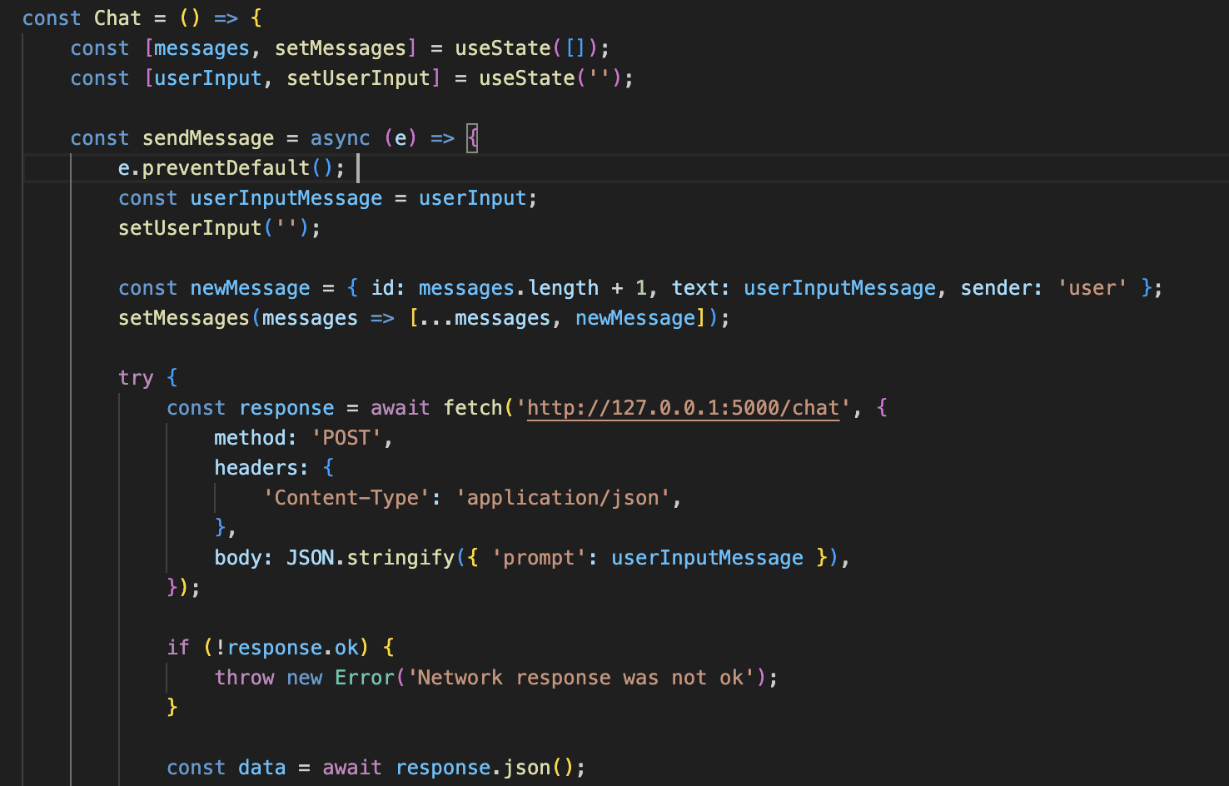
FRONTEND design
Chat component built using React. It allows users to send messages, which are then displayed in the chat interface.
Additionally, the component communicates with a backend server to generate bot responses based on user input, enhancing the interactive nature of the chat.

Slide 5
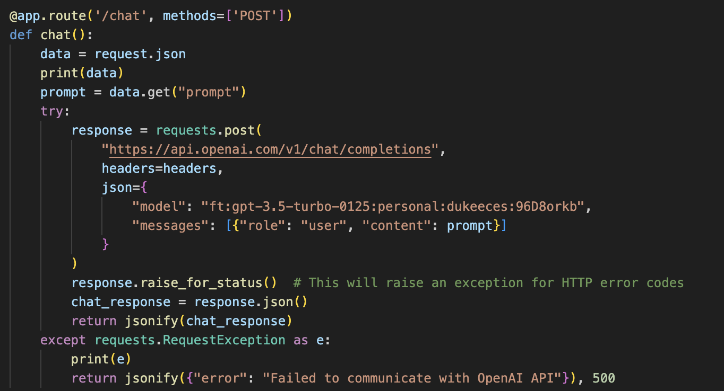
backend design
Based on Flask, receive the request from the front end and response from Open Ai API

Slide 6
demo

Slide 7
Thank you
YOUR GPT-based Course Selection Assistant

